Slide 1

Machine learning project
Autors: Sagy Bar Hod , Inbal Cohen
https://github.com/inbalcohen2/Machine-Learning-Project-Movies

Slide 2
Introduction
The process of making a film is long and with many steps until the film is released and released.
The course of the stages of film construction can predict a lot of data based on data that exists in the film and based on entire repositories of films.
Once there are lots of movies and lots of movie information analysis and a lot of data set you can predict a lot of data on movies that have not been released yet.
And that's what we'll be talking about in this project. If you enter data of movies that are about to be published - such as budget, genre, popularity, year, income, rating and more. - And when you want to get to something.

Slide 3
Data set we relied on
Selected database: https://www.kaggle.com/rounakbanik/the-story-of-film/data?select=movies_metadata.csv
The database contains information about movies, there are about 45,000 lines in the database and 24 columns.
'And based on this data, it is possible to predict various data on the film that has not yet been released, and in this way it is possible to improve performance and more.
The data in the database:
'adult', 'belongs to collection', 'budget', 'genres', 'homepage', 'id',
'imdb id', 'original language', 'original title', 'overview',
'popularity', 'poster path', 'production companies',
'production countries', 'release date', 'revenue', 'runtime',
'spoken languages', 'status', 'tagline', 'title', 'video',
'vote average', 'vote count'

Slide 4
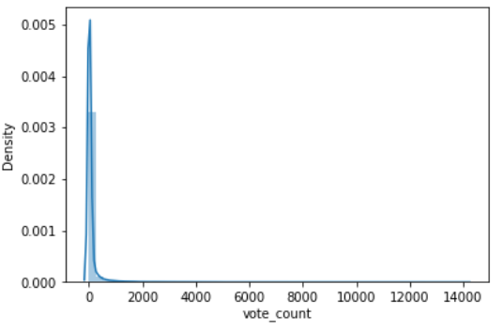
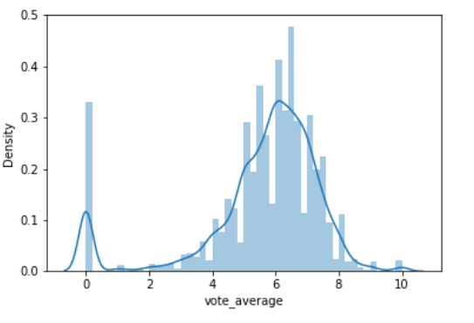
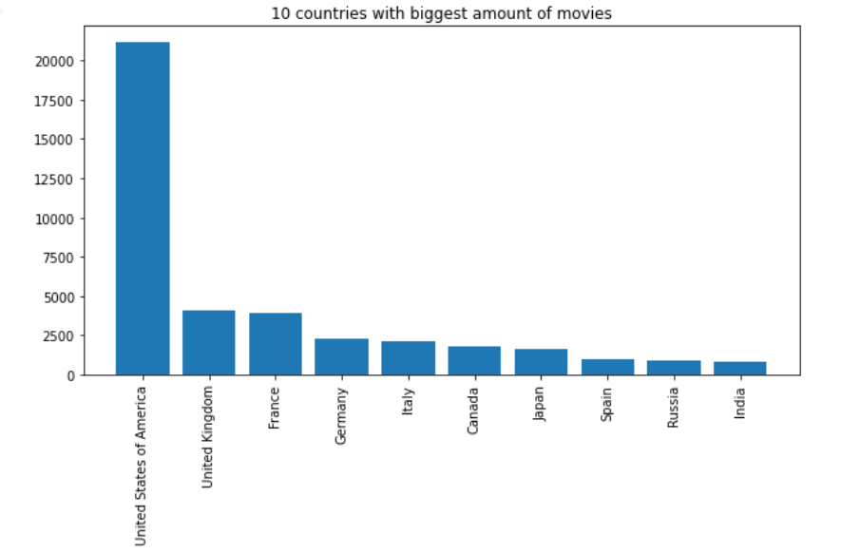
PCA- Principal Components Analysis
We first built some graphs as part of the PCA process that the goal was to find features that can help us predict and which features can be downloaded - this analysis reduces data - in order to lower the dimension of the data set ie the common use of this method is finding High dimension (a process called dimension lowering) Some of the graphs we presented: (EDA research data analysis)

Slide 5
The models we used in the project
First, we researched the same model and what its advantages are and why exactly it suits us for the same question we wanted to explore,
Decision tree - A decision tree is a prediction model that provides a mapping between observations and values ​​that are appropriate for them. In addition, it allows a visual visualization that is comfortable to the viewer's results, a simple and powerful model that manages with a large amount of data but on the other hand - is based on greedy algae which causes it to lack high optimality in some cases.
Logistic regression - a statistical model that describes the relationship between a qualitative variable (not quantitatively measurable - such as blood type or train line) "explained" and a "explanatory" variable by measuring the degree of effect of a change in value
k-nearest neighbors - A parameter-free algorithm in which the input depends on the k closest observations in the attribute space in the input of a new example, the algorithm assigns it to the group. The example will be associated with the most common class among k the nearest neighbors.
SVM - short for Support Vector Machine. This time, the classifier created in SVM is the linear divider which creates as much space as possible between it and the examples closest to it in the two categories. When a new point is displayed, the algorithm will detect whether it is located within the line that defines the group. Or outside it.
Naive bayes - a classification method, based on the Base Law and the naive assumption that there is no dependence between the properties of the classified objects and when we already know their classification, its ability to expand easily with the addition of data is its main plus
AdaBoost - short for Adaptive Boost, is a learning algorithm that searches for a small number of "strong" classifiers from a group of "weak" classifiers

Slide 6
The research questions - on which the project is based
The following research questions:
Is it possible to predict a genre of a particular movie?
Is it possible to predict movie revenue / profits?
Is it possible to predict a movie country?

Slide 7
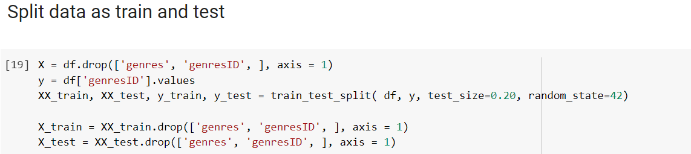
Preparation for operating the models
For each question we ran several models and before each model we ran we did a few steps:
First: we chose the question we are researching and then we selected the columns from the data set that are suitable for us to answer.
We divided the data into Y and X so that Y was the attribute we want to test and predict, and X was all the other attributes that are not Y.
We split the data into Test / Train and ran the five models.
In addition to each model we printed Confusion matrix and the accuracy of the model. We will see the analysis of the models below

Slide 8
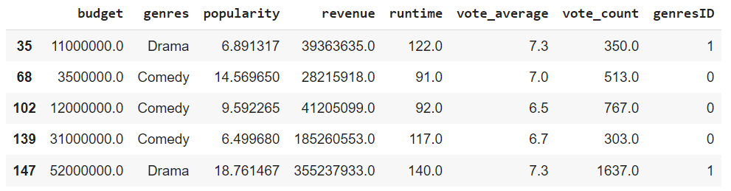
The first research question: Is it possible to predict the genre of a particular film?
To answer this question we used 5 models of machine learning. The columns we chose to leave in the table on which we will run machine learning are:
Budget - The budget of the film
Popularity - a popularity index, we converted all the values ​​in this column to scissors.
Genres - The movie genre
Revenue.
Runtime - The length of the movie
Vote average
Vote count - number of ratings
genres ID - a categorical column that we have created - gives a unique number for each genre.

Slide 9
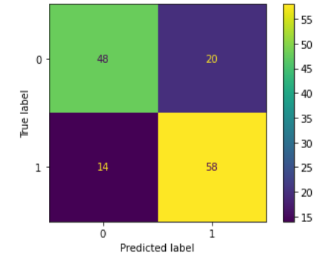
Model results
Take for example the Decision tree model in the first question we investigated:
We will go through the 3 steps through which we arrived at the results of each model: We created a confusion matrix that is used to describe the performance of a classification model on a set of test data for which the true values ​​are known, the y-axis symbolizes their true value while the x-axis symbolizes the model. Top left The model predicted 48 movies that are classified as 0 meaning that their genre is drama when their true value is really 0 (drama) and the value 1 is a comedy genre.
Test Accuracy: 0.7571428571428571

Slide 10
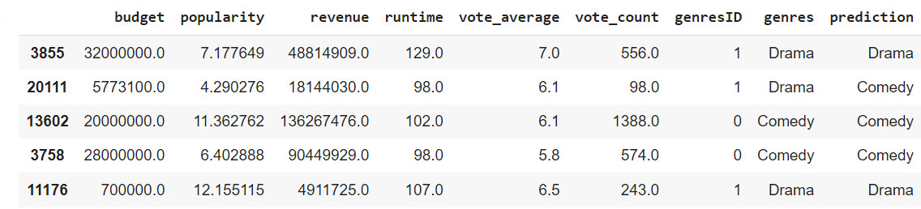
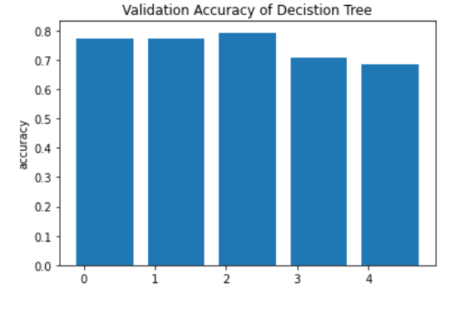
In this table you can see the prediction of the genre of the same movie (Y) based on the other data which are the other columns on which we ran the model and got the prediction results that this is the column surrounded by red.
This graph we presented is the accuracy of the model in the first 5 rows of the data table.
And all these steps we did for each model (in each of the questions we answered it)

Slide 11
Difficulties we faced in this question:
Difficulty we faced: There are too many genres in the data table and the amount of movies from each genre is uneven. There are genres with more movies and there are genres with less. To get to the relatively high accuracy of the model and solve this difficulty:
we chose the 2 genres with the most movies (comedy and drama) and ran the prediction on them. Indeed, we obtained results with a relatively high level of accuracy.

Slide 12
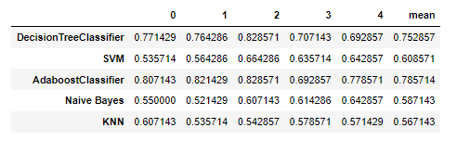
Results of the prediction and comparison between the 5 models
The model that brought the highest results was AdaBoost got the most accurate model for this learning problem. Followed by the Decision Tree Classifier.
While the KNN & NAÏVE BAYES models worked and stood at only 50% portrait yielded lower and less accurate results.

Slide 13
The second research question:
Is it possible to predict movie revenue / profits
In the second question since this is a continuous variable (income) then we could only use linear regression from the models we know because all the other models are classification models. The difficulty we faced in this question:
We can only use linear regression for these questions, since the income variable is a continuous rather than a categorical variable. We ran linear regression, but it did not give a good result. This shows that revenue cannot be predicted using linear regression in this data set. There is only one model that can help us, we could not accurately predict the revenue of a particular film and we got a high RMSE (average quadratic error) and a difference of 52405788. Between the predicted and true value - which shows a poor prediction. This is because there is no variable in DATASET that has a linear relationship to the Revenue variable we tried to predict and therefore the model fails to predict exactly the result. We have not been able to overcome this problem and reach a high enough accuracy.
The error was relatively high, that is to say - the predicted value was significantly far from the true value, so this model does not give accurate results and we can not rely on it.

Slide 14
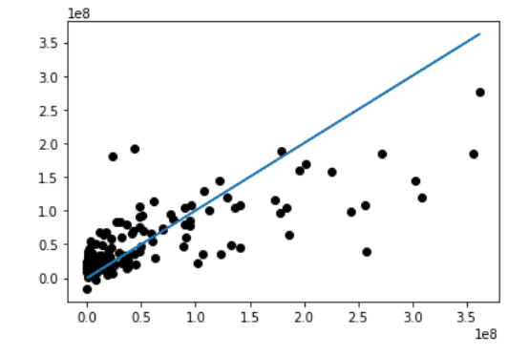
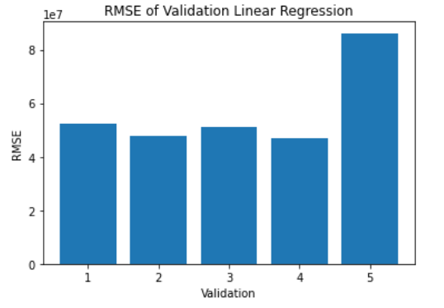
View data:
The score of linear regression is 0.55 and the RMSE between the real and projected income is 52405788. And from the graph on the right, we can see that the income is not linear for other variables. Thus, we could not use a linear regression model to predict revenue.
Revenues do not change categories and continue. Thus, we could not apply other methods to predict income, because other methods are classified. AdaBoost Classifier, Decision Tree Classifier, Gaussian NB, SVM, KNN, Logistic Regression can only be applied for classification problems.

Slide 15
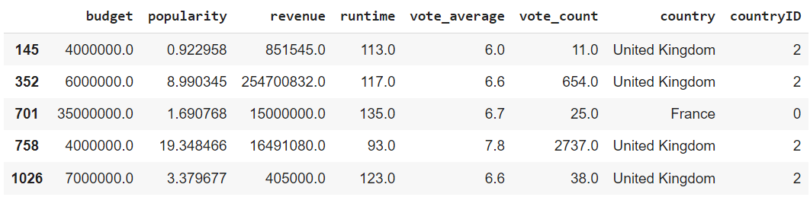
The third research question:
Is it possible to predict the countries in which the films were produced?
In this question we used the following columns:
Budget - The budget of the film
Genres - The movie genre
Popularity - a popularity index, we converted all the values ​​in this column to scissors.
Country ID - A category column that we have created, gives a unique number for each country.
Revenue.
Runtime - The length of the movie
Vote average
Country - The name of the country

Slide 16
Difficulties we faced in this question:
Difficulty we faced:
As in the question of genres, here too the amount of movies that came from each country is not evenly distributed so it is not possible to run machine learning on the whole dataset and we took the 3 countries with the highest amount of movies. France, Japan, and Britain.
In this question the best model was SVM and the models that worked less and stood at only about 50% accuracy are a decision tree and logistical regression.
In this question we used 6 different models.

Slide 17
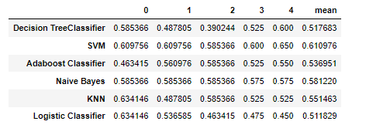
Results of the prediction and comparison between the 6 models
The model that yielded the highest results was SVM.
while the decision tree and linear regression models worked and stood at only 50% accuracy and therefore yielded lower and therefore less accurate results.

Slide 18
Summary
After examining the various models and trying to answer 3 different research questions that deal with predicting data on movies based on databases of movies that have already come out.
We learned a lot about the different models, about the pros and cons of each and how each contributed to us answering the questions and pinpointing the results in the best way.
We would like to thank Professor Liad Gottlieb. Lecturer in a machine learning course at Ariel University. For accompaniment throughout the course, in-depth learning and for all the support and help around the assignments and the final project.

